Slide 1
Term Project: Group I
Faith Olasupo | Lillie Hunter | Cyrus Andre | Ric Johnson

Slide 2
Project Guidelines
Presented Problem
Creating a game that will help Delaware State University students understand subjects in Computational Thinking I
Solution
Build a game that allows students to learn the precedence of logical operators through Rock Paper Scissors
Caters to kinesthetic learners
Notes:
Faith

Slide 3
Design Thinking

Slide 4
PHASE 1
PHASE 2
PHASE 3
Empathize
Define
Ideate
Develop a deep understanding of the challenge problem
Clearly articulate the problem you want solve
Brainstorm potential solutions, select and develop your solutions
PHASE 4
PHASE 5
Prototype
Test
Design a prototype and and test all of part of your solution.
A continuous short-cycle innovation process to improve your design
Notes:
Faith

Slide 5
Problem Statement
POV
Delaware State University computer science and information technology students taking computational thinking 1 need an entertaining game to learn logical connectives because they find the topic difficult to understand and an entertaining game will capture their attention and help them spend more time practicing the concepts.
Notes:
faith

Slide 6
Ideation
Brainstorm
Create a game for each learning type
Visual, Kinesthetic, Auditory
Availability
Online, Offline
App
Reward system and competitive features
User friendly
Customization
Colorful and easy to navigate

Slide 7
Ideation (Cont.)
LOW
FEASIBILITY
HIGH
Prioritize HMWs
Organize ideas under HMW
Which ideas are the most feasible?
Focused on specific learning style
Kinesthetic
How might we implement a study feature in the game
How might we develop a game that is easily accessible to all users
How might we develop a game that is easily accessible to all users
How might we develop a game that is easily accessible to all users
How might we accommodate for people with different learning styles
How might we develop a more competitive game to incentivize learning
How might we create a user interface that makes the intended audience intrigued
How might we create a user interface that makes the intended audience intrigued
How might we implement a study feature in the game

Slide 8

Prototype
IDLE
Used for prototyping
Developing basic mechanics of the game
Users enter 10 rounds with Computer, declares a winner at the end

Slide 9

Final product
Godot
Python based API
Implement buttons
Recorded point system
Give an explanation of “why” the user or computer won

Slide 10
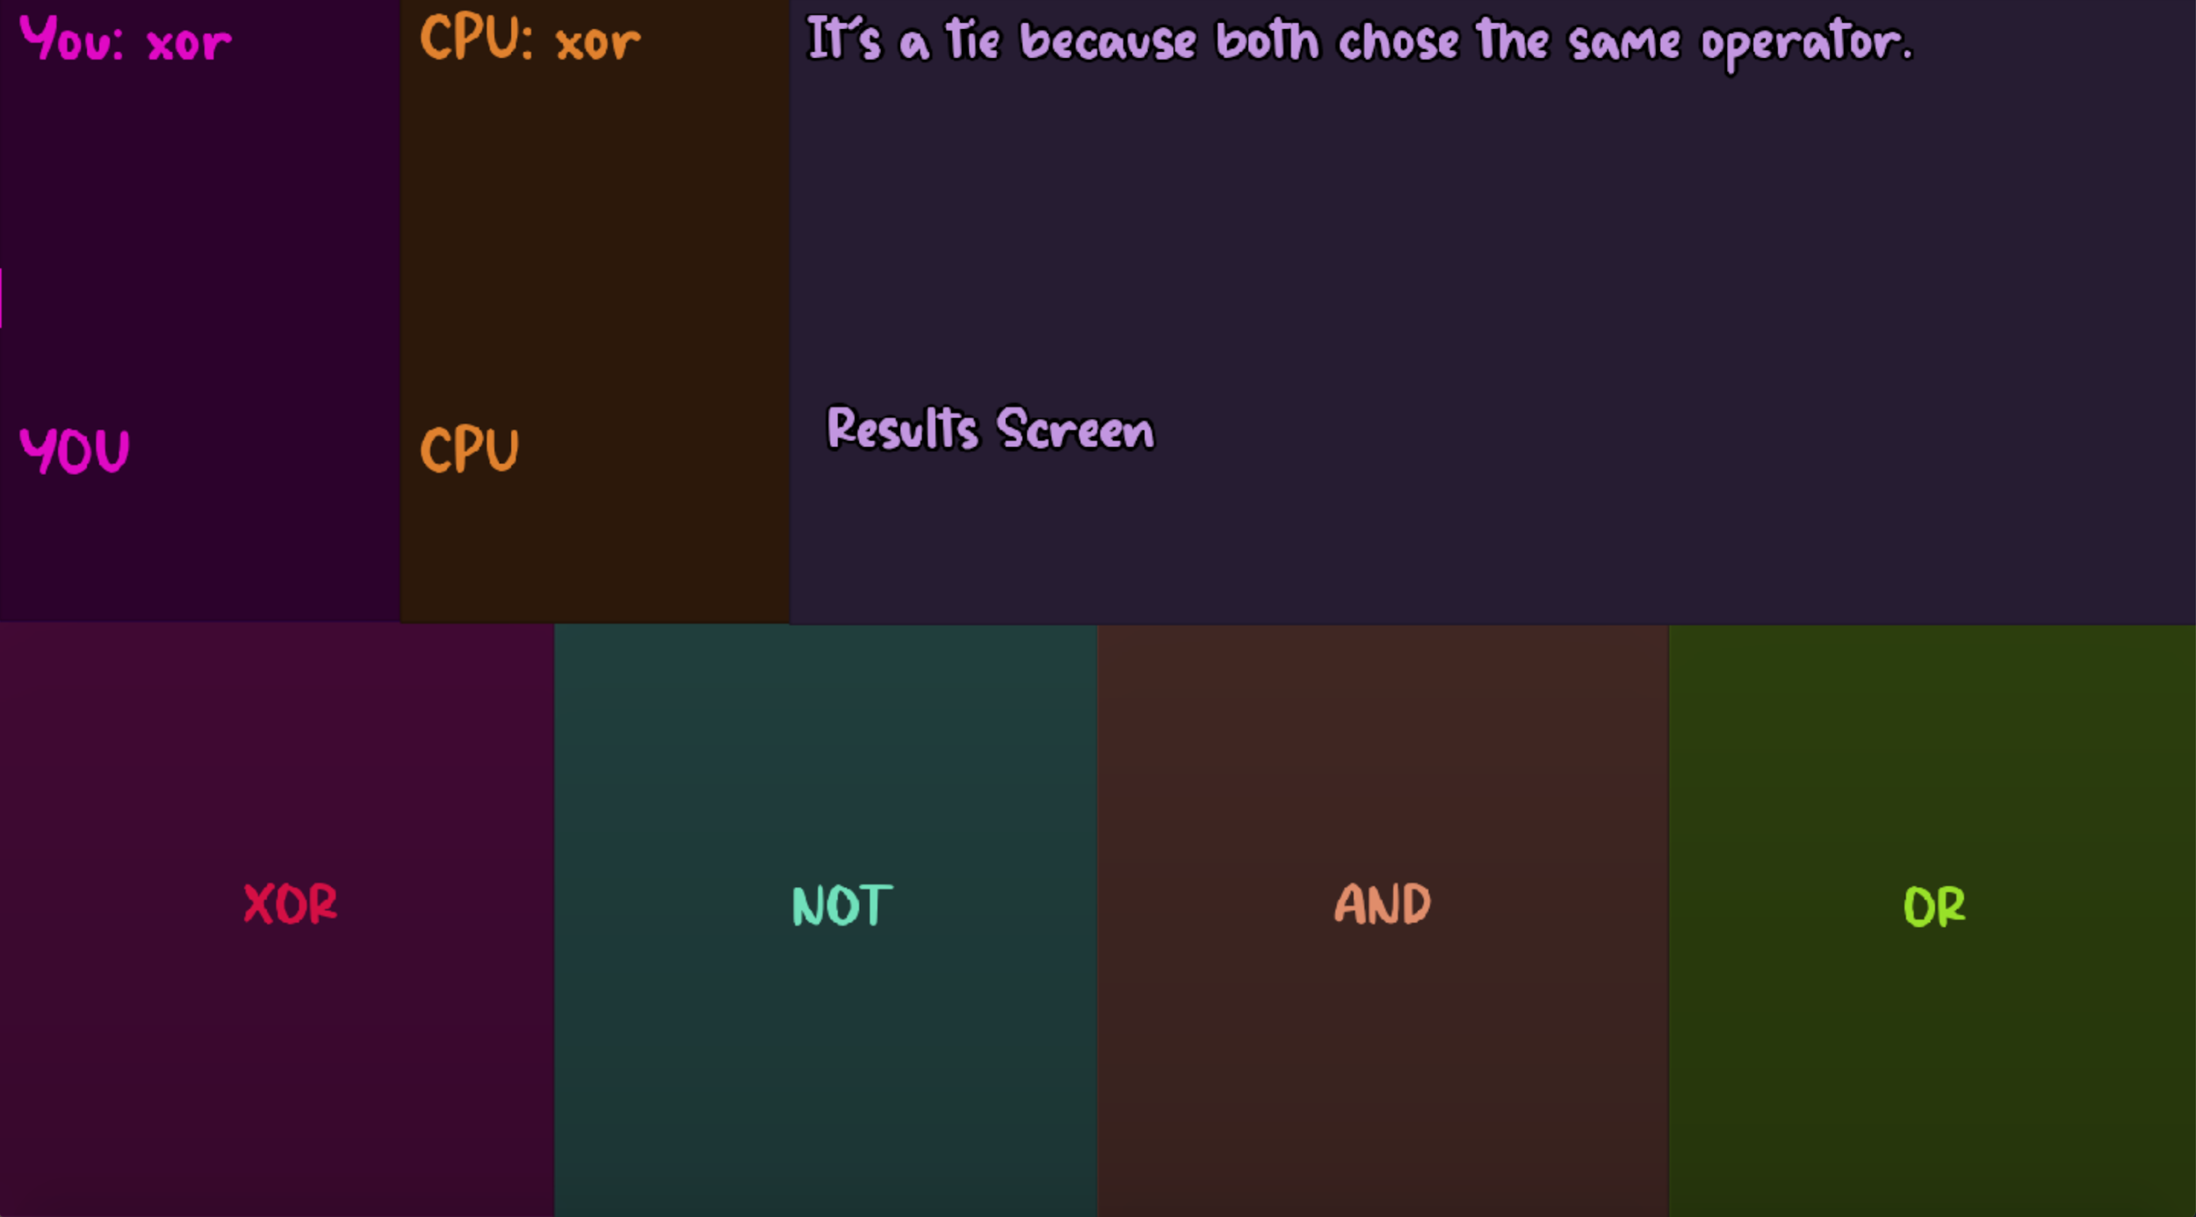
Game Objectives
Explanation
Similar to Rock Paper Scissors (“Which counters which?”)
Teaching the precedence of logical operators
XOR,OR,AND,NOT
Essential to understanding, in what way does a computer evaluates expressions
Troubleshooting

Slide 11
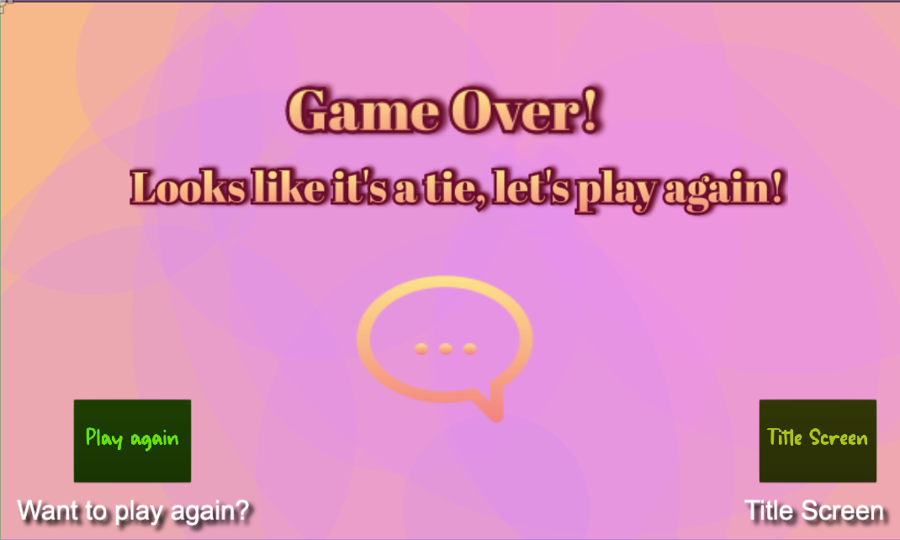
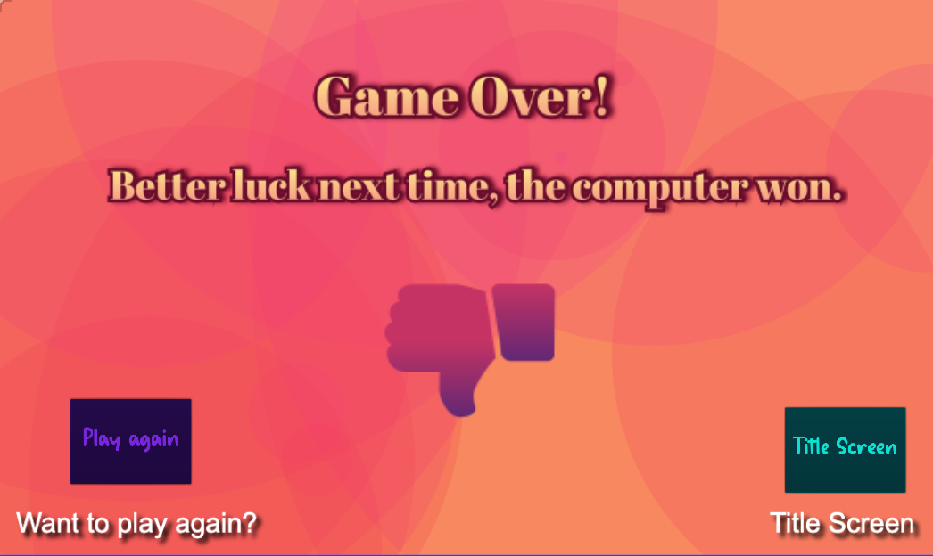
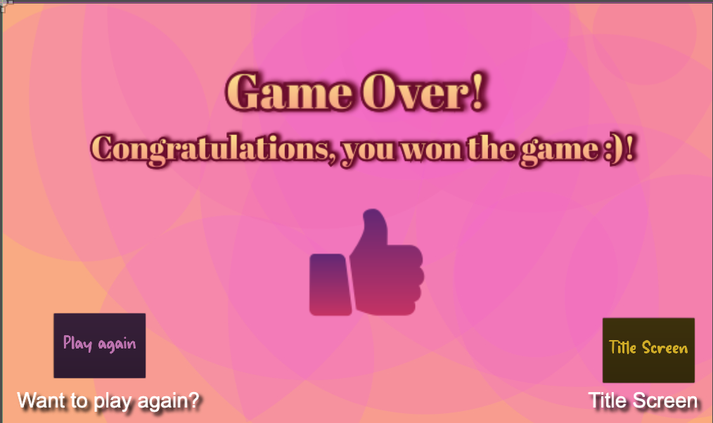
Instructions
There will be 10 rounds between:
User and Computer
Each player has a hidden point score
Increments by 1 for each winning round
No points are given for ties
Most points declares the winner

Slide 12
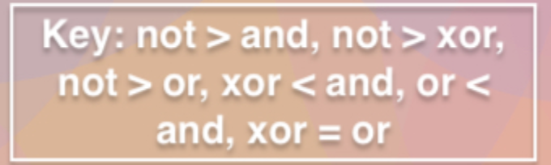
Tools
Rules
NOT (Highest precedence)
AND
OR / XOR (Lowest precedence)
Key
NOT > AND , NOT > OR, NOT > XOR , OR < AND , XOR < AND
OR = XOR

Slide 13
Methodology

Slide 14
Agile[Scrum]
Utilized Scrum management process to develop a solution for a complex problem
Scrum Master
Product Owner
Team
Lillie
Cyrus
Faith & Ric
Goal setting
Organization of ideas and creativity
Group productivity
Innovative
Personal management techniques
Quick & Efficient
STRENGTHS
Time management for certain features
Feasibility
Organization
Time pressure
Adopting Scrum framework
Workflow coordination
WEAKNESSES

Slide 15
Summary
Identified a complex problem with students failing to understand a subject
Used design thinking to achieve the most innovative solution

